Slide 1

STAT628-Module 3 Suggestion for pizza business
Yicen Liu
Hua Tong
Enze Wang

Slide 2
Introduction and Preparation
Give data-driven and action suggestion for business on Yelp
Four json files including more than 900000 reviews and 36000 businesses.
What business category should we study?
What kinds of suggestion should we provide?
How we study data and build our model?
First transfer json into csv file
Unfold integrated columns (attributes & hours)

Slide 3
Data Clean
We only study business from ﻿Madison, Cleveland, Pittsburgh, Urbana-Champaign. Remove business who is far away from centers of the four cities.
Select pizza business, there are about 1500 pizza business and 67000 related reviews. We think it is enough.
Clean business table whose null value ratio is too large. Clean every column values carefully. (More than 20 columns)
We focus only on reviews in English, remove other reviews.

Slide 4
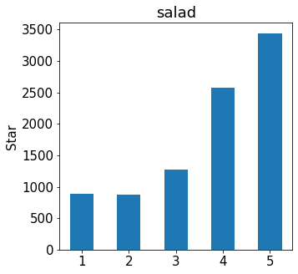
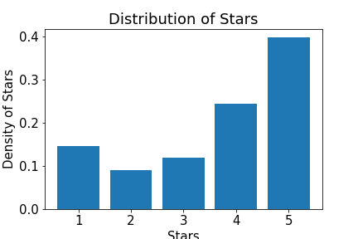
Exploratory Data Analysis
Find distribution of stars and classified by city and growth in month.
Split reviews, lemmatize, clean punctuation and stop words and calculate word frequency.
Stars
rating
Word Frequency Table
Word
pizza
good
places
i
am
Remove stop words
Lemmatize
Count frequency
Split reviews
Use lowercase
Word | Frequency
pizza | 97915
good | 40169
place | 36894
… | …
All reviews

Slide 5
Our Target Business and Suggestion
Our target business is all pizza business from four cities.
We have more than 1500 open pizza business and more than 67000 related reviews.
We decide to raise suggestions from three aspects:
Business suggestion: Which business attribute are highly related to your business star rating, such as offering alcohol or not, what should business do? (business_city.json)
Menu suggestion: How to expand your menu, which food are highly related to review star rating and whether add or remove it? (review_city.json)
Review suggestion: For every business, what food or service are customers mainly complaint or praise? How they mention in review and what can business do next? (review_city.json)

Slide 6
Business Suggestion-Method
Data: business.json
Main method: ANOVA & T test
Check test assumption
Do test and calculate mean difference
Goal: Find significant business attribute whose business star rating difference among options are significant and which option is higher rating one.
Which option has high business star rating on Yelp? There are more than 10 attribute.
Business attribute | Option1 | Option2 | Business star rating with option1 | Business star rating with option2
Alcohol | Offer alcohol | Do not offer alcohol | Y1=[3,4,5,3.5,2,...] | Y2=[1,2,2.5,1...]
TV | Offer TV | Do not offer TV | Y1=[3,3,2,3.5,5,...] | Y2=[3,2,1,1...]
Park for car | Offer park for car | Do not park for car | Y1=[3,3,4,3.5,5,...] | Y2=[2,2,2.5,3...]
… | … | … | ... | ...

Slide 7
Business Suggestion-Results & Suggestion
We find 9 significant business attributes (part results):
Business attribute | High rating option | Low rating option | Star rating difference | Suggestion
Alcohol | Offer Alcohol | Do not offer alcohol | 0.18 | We suggest you offer alcohol drink
Reservation | Offer reservation | Do not offer reservation | 0.21 | We suggest you offer reservation
Park for car | Offer park for car | Do not park for car | 0.36 | We suggest you offer park for car
Delivery | Do not offer delivery | Offer delivery | 0.53 | You should check delivery quality and keep food fresh on the way if you offer delivery
… | … | … | … | …
We will give suggestion according to your data in business.json
Welcome visit our Shiny app to find your business and get suggestion there.

Slide 8
Menu Suggestion & Review Suggestion-Word Rank
Word TF-IDF Rank
Word Frequency Rank
Word | TF-IDF
pizza | 0.0146
good | 0.0111
food | 0.0105
… | …
Find important word for menu suggestion and review suggestion.
Use TF-IDF and regression tree to get word rank.
TF-IDF is focused on word occurrence but regression tree is focused on the connection between word frequency and review star rating.
Word | Freq
pizza | 97915
good | 40169
place | 36894
food | 34945
great | 29749
time | 27346
like | 22193
order | 21334
… | …
Word Tree Regression Rank
Word | Importance
delicious | 0.0731
great | 0.0725
worst | 0.0450
… | …

Slide 9
Menu Suggestion & Review Suggestion-Word List
Important Noun
pizza
food
waiter
delivery
…
Food Noun
salad
chicken
beer
pasta
...
Word TF-IDF Rank
Word | TF-IDF
pizza | 0.0146
good | 0.0111
food | 0.0105
… | …
For Menu Suggestion
We can make suggestion for them
Positive Word
good
affordable
nice
...
Important positive Word
affordable
delicious
respectful
...
Word Regression tree Rank
For Review Suggestion
Word | Importance
delicious | 0.0731
great | 0.0725
worst | 0.0450
… | …
Negative Word
bad
expansive
rude
...
Important negative Word
expansive
rude
delayed
...
For Review Suggestion

Slide 10

Menu Suggestion-Method
 | Review Star Rating (Y) | Salad (X1) | Chicken (X2) | Beer (X3)
Review 1 | 5 stars | 3 | 2 | 3
Review 2 | 1 star | 0 | 3 | 4
Review 3 | 3 stars | 2 | 1 | 0
… | … | … | … | …
Data: review.json, 1560 reviews and 125 food nouns.
Main method: Linear & Lasso Regression
Goal: Find the connection between frequency of food noun with review star rating. Whether it is necessary to add or remove some food from menu to increase review star rating?

Slide 11
Menu Suggestion-Results & Suggestion
About 50 significant food nouns in Lasso Regression
The more frequent in reviews of beer, wine, sausage, mozzarella... the mean of review star rating will increase.
The more frequent in reviews of shrimp, fish, marinara... the mean of review star rating will decrease.
We will search your review and find whether target food noun occur or not, and build customized suggestion for you. (Offer beer or avoid shrimp...)
Word | Coefficients
beer | 0.0420
wine | 0.0732
sausage | 0.0394
bacon | 0.0735
mozzarella | 0.1091
... | ...
Positive coefficients means that they are positively correlated with review star ratings.

Slide 12
Review Suggestion-Review Attitude Function
reverse attitude if there is
negative adverb “no”, ”not” and “never” in front of it
How we judge review attitude:
Input: “it is a good coke! the pizza here is not good. the coke here is really nice!”
Count: positive: 2 elements: good, nice
negative: 1 elements: not good
Output:
if positive > negative: Positive review (1)
else if positive < negative: Negative review (-1)
else positive = negative: Neutral review (0)
Many reviews contain neither positive nor negative word list, so there are a lot of neutral reviews.
Example:
Input: it is delicious
Output: Positive
Input: there are totally no sick food here
Output: Positive
There is no perfect way to build review attitude function. Further study can make our function better.
reverse attitude if there is “no”, ”not” and “never” in front of it

Slide 13
Review Suggestion-Review Split
After clean review by lowercase and lemmatization. How we judge a target review attitude towards a target word?
Input:
Target word: coke Target review:
“it is a good coke! the pizza here is not good. the coke here is really nice!”
Split review by . ! ? ; etc, which are usually used to cut sentence.
[“it is a good coke”, “the pizza here is not good”, “ the coke here is really nice” ]
Find all small reviews contain target word and combine them as a big review:
“it is a good coke. the coke here is really nice.”
Judge the target review attitude towards target word.
Output: Positive (1)

Slide 14
Review Suggestion-Review Matrix
Review attitude matrix
The i th review’s attitude toward j th important noun
1 as positive; 0 as neutral; -1 as negative; nan as review does not contain this word.
Positive word count list
The i th review contains what positive word when mention j th important noun.
We have corresponding negative, important positive and important negative word count list. Total 4 lists.
 | food (X1) | pizza (X2) | cheese (X3)
Review1 | good delicious
Review2 |  | delicious, great | affordable
Review3 | respectful |  | nice
... | ... | ... | ...
 | Review star rating (Y) | food (X1) | pizza (X2) | cheese (X3)
Review1 | 5 stars | 1 | -1 | nan
Review2 | 1 stars | nan | 1 | 0
Review3 | 3 stars | 0 | nan | 1
... | ... | ... | ... | ...

Slide 15
Review Suggestion-Significance test
Data: review.json, 1560 reviews and 286 important nouns.
Main method: ANOVA, T test
Goal: Find whether the difference among mean reviews star rating of positive, neutral and negative reviews towards a target word is significant.
Word | Review star rating of positive reviews | Review star rating of neutral reviews | Review star rating of negative reviews
pizza | X1=[3,4,5,5,3,2,...] | X2=[2,3,4,3,3,1,...] | X3=[1,3,1,2,3,2,...]
delivery | X1=[5,4,3,5,5,2,...] | X2=[5,3,3,3,3,1,...] | X3=[2,3,5,2,1,2,...]
... | ... | ... | ...

Slide 16
Review Suggestion-Results
T test results. Most mean star rating of positive reviews are larger than negative ones
ANOVA: For 110 keywords whose reviews are enough, their mean difference among star rating of positive, negative and neutral reviews are significant
T test: For 110 keywords above, the mean review star rating of positive is significantly larger than negative ones.
But how you increase more positive reviews and avoid negative reviews?
Keyword | Mean star rating of positive reviews | Mean star rating of negative reviews | Difference (positive-negative)
pizza | 4.1 | 2.4 | 1.7
food | 3.9 | 2.0 | 1.9
cheese | 3.9 | 2.8 | 1.1
... | ... | ... | ...

Slide 17
Review Suggestion-How We Give Suggestion
It is difficult to give suggestion for “good”, “nice”. But it is easy to give suggestion for them:
The top 3 important positive words in all reviews mention keyword and their count:
Keyword | Top1 | Count | Top2 | Count | Top3 | Count
pizza | delicious | 2808 | fresh | 1644 | free | 692
delivery | delicious | 73 | free | 55 | fresh | 55
staff | clean | 201 | delicious | 163 | fresh | 89
... | ... | ... | ... | ... | ... | ...
We write suggestions for both positive and negative sides for all 110 keywords.
There are total 220 suggestions.
The top 3 important negative words in all reviews mention keyword and their count:
Keyword | Top1 | Count | Top2 | Count | Top3 | Count
pizza | rude | 138 | snob | 111 | sick | 56
delivery | rude | 68 | lazy | 21 | unprofessional | 8
staff | rude | 183 | unprofessional | 21 | disorganized | 13
... | ... | ... | ... | ... | ... | ...

Slide 18
Review Suggestion-How We Give Suggestion
Your business
All your business reviews
All reviews contains delivery
We find there are more than 5 reviews mention delivery
Positive, neutral, negative reviews counts. (customized)
How you can increase positive reviews and avoid negative reviews. (overall)
Sample Suggestion:
There are total 9 reviews mention delivery 2 of them are positive, 6 of them are neutral, 1 of them are negative. The top positive words in overall analysis are delicious free fresh . It is a good idea to perfect your delivery food to be more delicious, fresh and economical to win more positive reviews. The top negative words in overall analysis are rude lazy unprofessional . Customers love delivering their food faster, mannerly and get food fresh as in restaurants; please improve your delivery speed and quality.
Customized
For all business

Slide 19
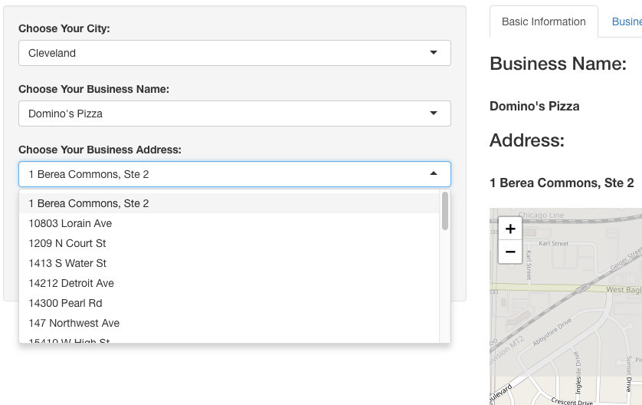
Shiny Application-Basic Information
Welcome to use it on:
https://ewang36.shinyapps.io/m_3_app/
Choose city (﻿Madison, Cleveland, Pittsburgh, Urbana-Champaign), name and address on the left column.
By those three inputs we can determine a unique pizza business just like business_id.
All information and suggestion is on the right column.

Slide 20
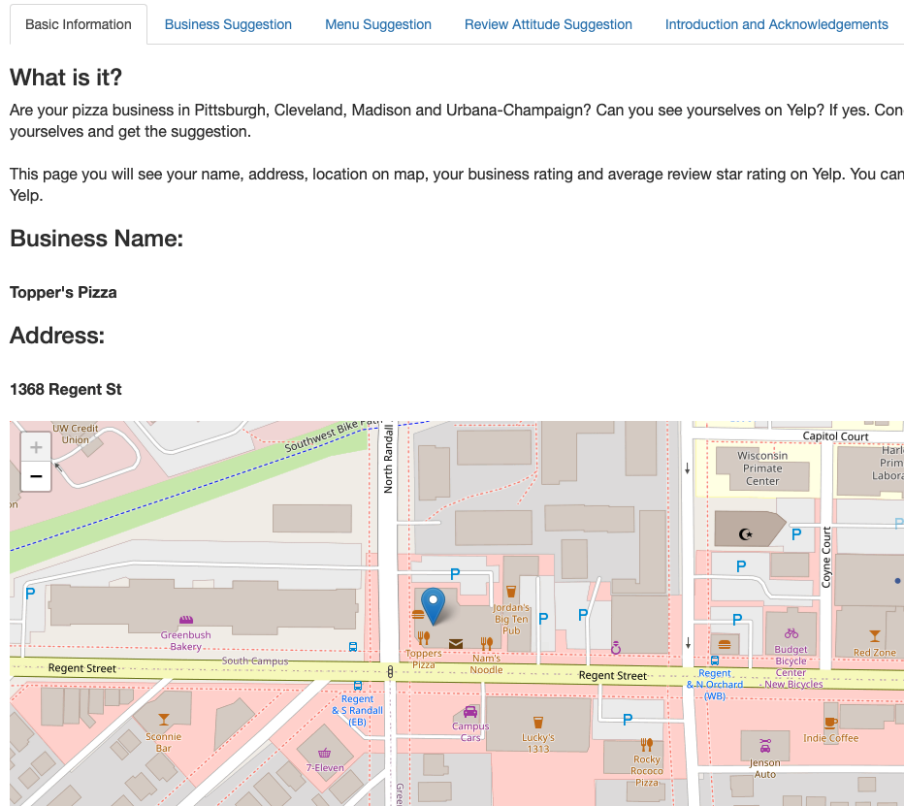
Shiny Application-Basic Information
Five pages on the right column:
The first page is Basic Information including business location on map.

Slide 21
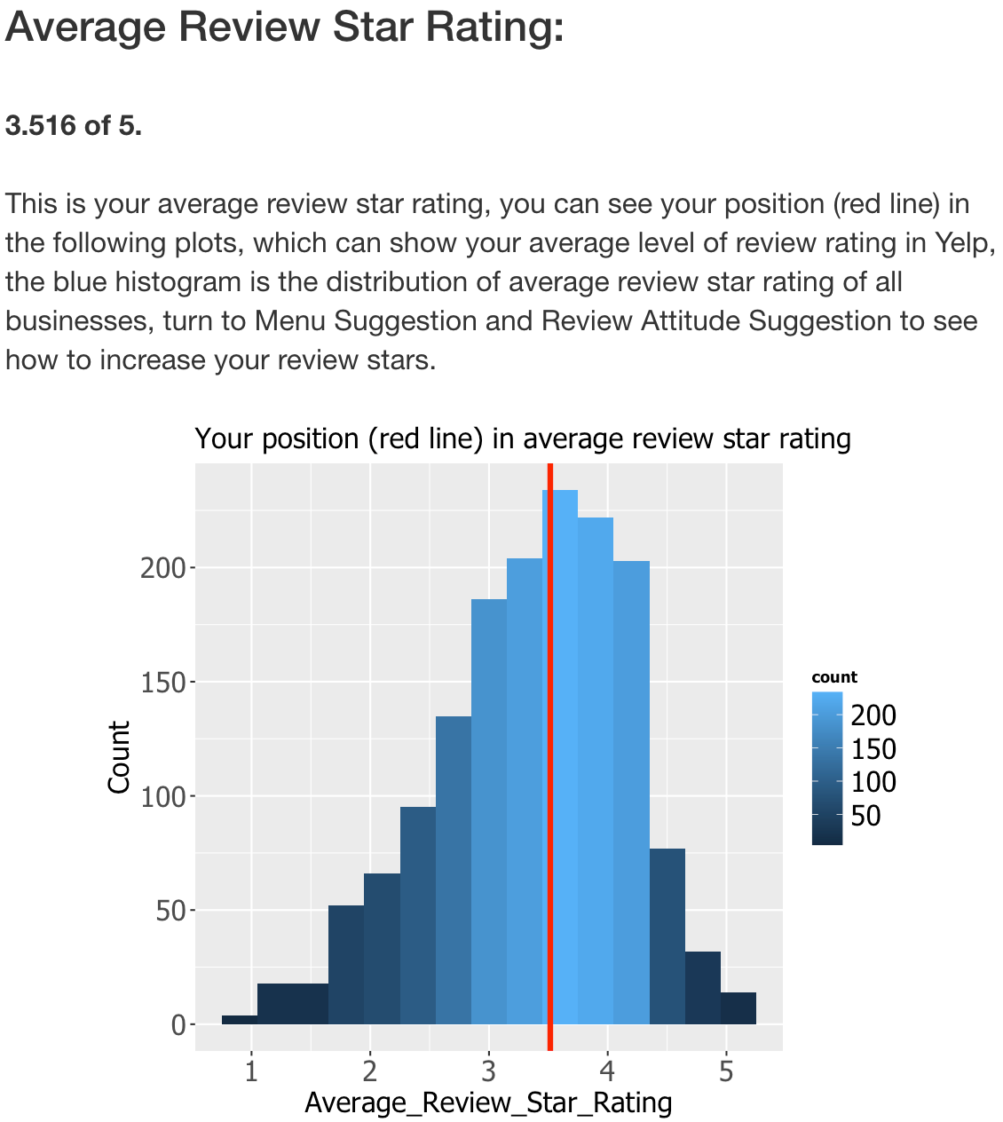
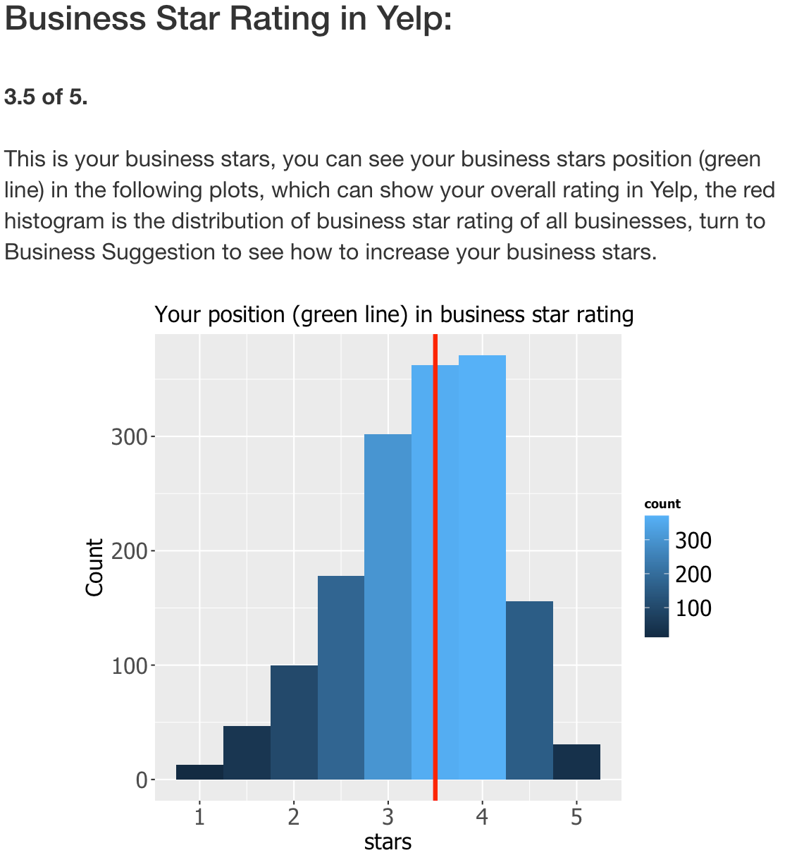
Shiny Application-Basic Information
You can also find your position (red line) in business star rating, average review star rating and total reviews number in basic information page too.

Slide 22
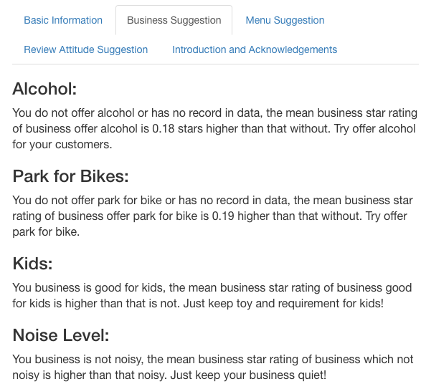
Shiny Application-Business Suggestion
You can get what you should do in business attributes to increase business star rating.
Our suggestion is customized based on your business reality.
There are 9 kinds of business attributes and here is part of page.

Slide 23
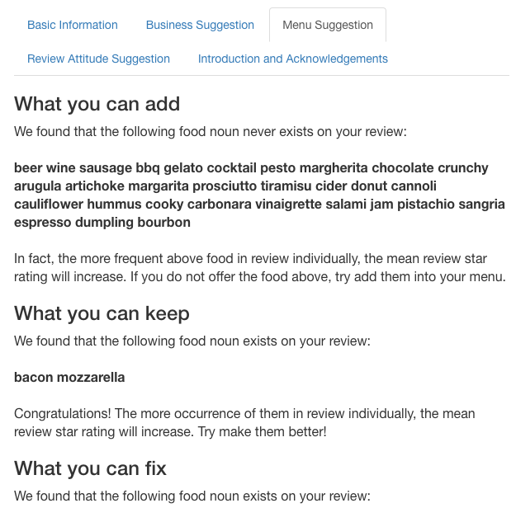
Shiny Application-Menu Suggestion
You can get what you should do to expand menu.
Our suggestion is customized based on food occurrence in your reviews.
There are four kinds of suggestion:
What you can add (Positive food not occur in review)
What you can keep (Positive food occur in review)
What you can fix (Negative food occur in review)
What you can avoid (Negative food not occur in review)
and here is part of page.

Slide 24
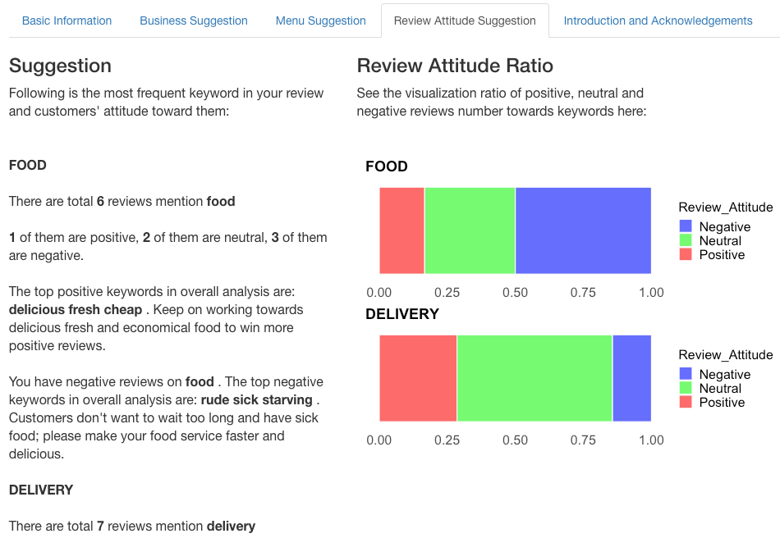
Shiny Application-Review Suggestion
You can get customized review analysis here:
Important noun in your review:
Total number of review mention it:
Positive, Neutral and Negative reviews number here:
Top 3 Positive keywords in overall analysis and our suggestion:
Top 3 Negative keywords in overall analysis and our suggestion:
Have review attitude ratio visualization here.

Slide 25
Summary
Advantage
Most of our suggestion is customized .
Our Shiny application and suggestion are constructive and informative .
Disadvantage
Review attitude function is not perfect.
We can still expand our noun word list and positive, negative word list.
It is not a perfect way to use linear and lasso regression on word count matrix.
We can use more advanced method to build our model.
Further study reviews to make more detailed and informative customized suggestion in review suggestion part.

Slide 26
Thank you!
Shiny application:
Fixed by Yicen Liu and Hua Tong
Main edited by Enze Wang
GitHub and Main Code:
Business suggestion edited by Hua Tong
Regression tree edited by Yicen Liu
Review analysis, data clean and wash, EDA, menu suggestion and suggestion writer are edited by Enze Wang
Presentation:
Video edited by Hua Tong and Yicen Liu
PPT file edited by Enze Wang
Summary:
Edited by Hua Tong
Fixed by Yicen Liu and Enze Wang

